Slide 1
Report
Dec-2023 MP Inspection BFX – UA300
Date : 20-Feb-2024
Prepared by: PE Long & QA Rachel Ruan

Slide 2
Issue Description
Jan-2024, ALT customer complain [BFX-UA300] Dec – 2023 Mass production issue.
Overall inspection result => Conditional Pass
Defect Total:
Defect Total
• Critical
No boot * 1pcs
Noise sound – R channel * 1pcs
• Major
No sound * 1pcs
• Minor
HDMI cable NG * 1pcs Cable scratch

Slide 3
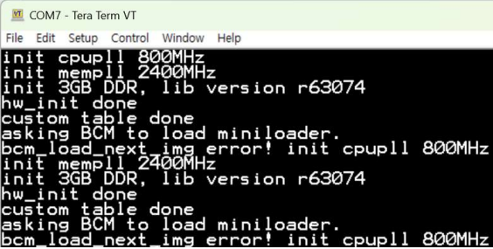
1. No boot* 1pcs
Issue Description | FA | Rootcause | Actions | Status
Symptom: No boot Type: Critical Defect unit Q’ty : 1/316pcs Defect rate : 0.31% SKB SN: 2149695001202303021988 | ALT initial review • Visual check : No found abnormal. • Console log: Abnormal- bcm_load_next_img error ======================================= 1. Check SMT data - The product is produced OK normally 2. Check FATP data - History data: Product test pass normally. - Recheck all logtest (Funtion test coverage): No find out abnormal (Pass FATP and ON/OFF station) Conclusion: - SMT, FATP data OK normal ➔ This issue can be cover 100% at the Fii factory. | - Follow to the console log data provided by ALT customer, found out abnormal stop bcm _load _ next_img error! Init cpuall 800mhz ➔ Suspect U1 issue. | → Send material U1 location to vendor Synapstic further analyze.

Slide 4
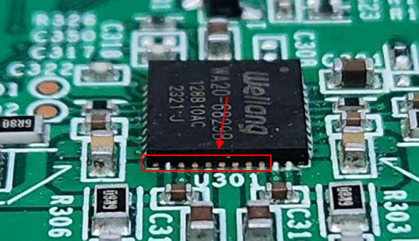
2. Noisy sound – R channel * 1pcs
Issue Description | FA | Rootcause | Actions | Status
Symptom: Noisy sound output Type: Critical Defect unit Q’ty : 1/316pcs Defect rate : 0.31% SKB SN: 2149695001202303021730 | ALT initial review • Visual check : found abnormal ➔ PCBA 96.1531T00 (AMP IC) is not soldered . =========================================== 1. Check SMT data - Machine warning insufficient solder U301 position but OP skipped. - Recheck this MO again( Produced in Nov-2023), there is only 1pcs with U301 location defect. (Defect rate: 1/1888~529DPPM) 2. Check FATP data Product test pass normally (Focus FT2 station) 3. Recheck all logtest (Funtion test coverage): → No find out abnormal | Occur cause - U301 location has open solder (Solder PIN connections is not good lead to defective products being delivered to customers) Escape cause - Machine warning insufficient solder U301 position but OP skipped. | 1. Re-training OP test AOI . Add U301 defect image to training test AOI program. 2. Update SOP , VI all position as H.1 image after reflow 3. Require ALT send NG sample to Factory for analysis and re-verify AOI,FATP.

Slide 5
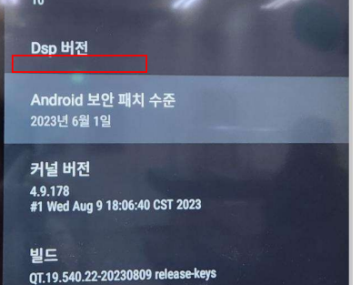
3. No sound* 1pcs
Issue Description | FA | Rootcause | Actions | Status
Symptom: No sound after 10mins of booting Type: Major Defect unit Q’ty : 1/316pcs Defect rate :0.31% SKB SN: 2149695001202303021211 | ALT initial review • DSP version N/A • Visual check : found abnormal - FFC is shorted to GND - Kepton tape on the FFC, is not alighed ====================================== 1. Check FATP data Product test pass normally 2. Recheck all logtest (Funtion test coverage): → No find out abnormal | Occur cause - FFC is shorted to GND Escape cause - Require ALT customer provide picture NG to Fii factory for analysis and verify escape cause. | - Require ALT customer provide picture NG to Fii factory for analysis and verify escape cause.

Slide 6
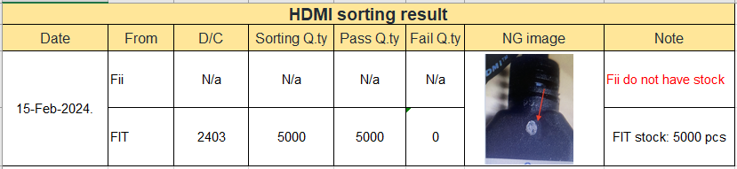
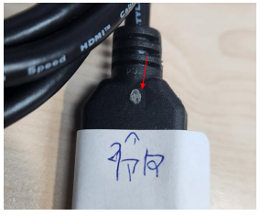
2. HDMI Cable – No TV screen * 2pcs
Issue Description | FA | Status
Symptom: HDMI Cable – cosmetic NG *1psc Type: Minor, Defect rate : 0.31% Defect unit Try : 1/316pcs ALT customer Visual check :. HDMI Cable scratch | 1. 26-Jan/2024 Fii feedback to FIT vendor 01 pcs HDMI Cable – cosmetic NG. 2. 2024/02/15 FIT provide sorting result the HDMI cable on vendor stock. 3. IQC inspection material incoming will up checking rate from AQL 0.65 to AQL 0.4 from the lots.

